Slide 1
What Demographics Affect Income?

Slide 2
What type of person makes over 50k a year?
Does Race matter?
Does Gender?
These are commonly asked questions in our society:
For example, take a single black woman. Is it harder for her to be successful?
Let’s find out.

Slide 3
The Data
Categorical Attributes
Workclass: Private, Self-emp-not-inc, Self-emp-inc, Federal-gov, Local-gov, State-gov, Without-pay, Never-worked.
Education: Bachelors, Some-college, 11th, HS-grad, Prof-school, Assoc-acdm, Assoc-voc, 9th, 7th-8th, 12th, Masters, 1st-4th, 10th, Doctorate, 5th-6th, Preschool.
Marital-status: Married-civ-spouse, Divorced, Never-married, Separated, Widowed, Married-spouse-absent, Married-AF-spouse.
Occupation: Tech-support, Craft-repair, Other-service, Sales, Exec-managerial, Prof-specialty, Handlers-cleaners, Machine-op-inspct, Adm-clerical, Farming-fishing, Transport-moving, Priv-house-serv, Protective-serv, Armed-Forces.
Relationship: Wife, Own-child, Husband, Not-in-family, Other-relative, Unmarried.
Race: White, Asian-Pac-Islander, Amer-Indian-Eskimo, Other, Black.
Sex: Female, Male.
Native-country:
Continuous Attributes
Age
Capital-loss
Hours-per-week

Slide 4
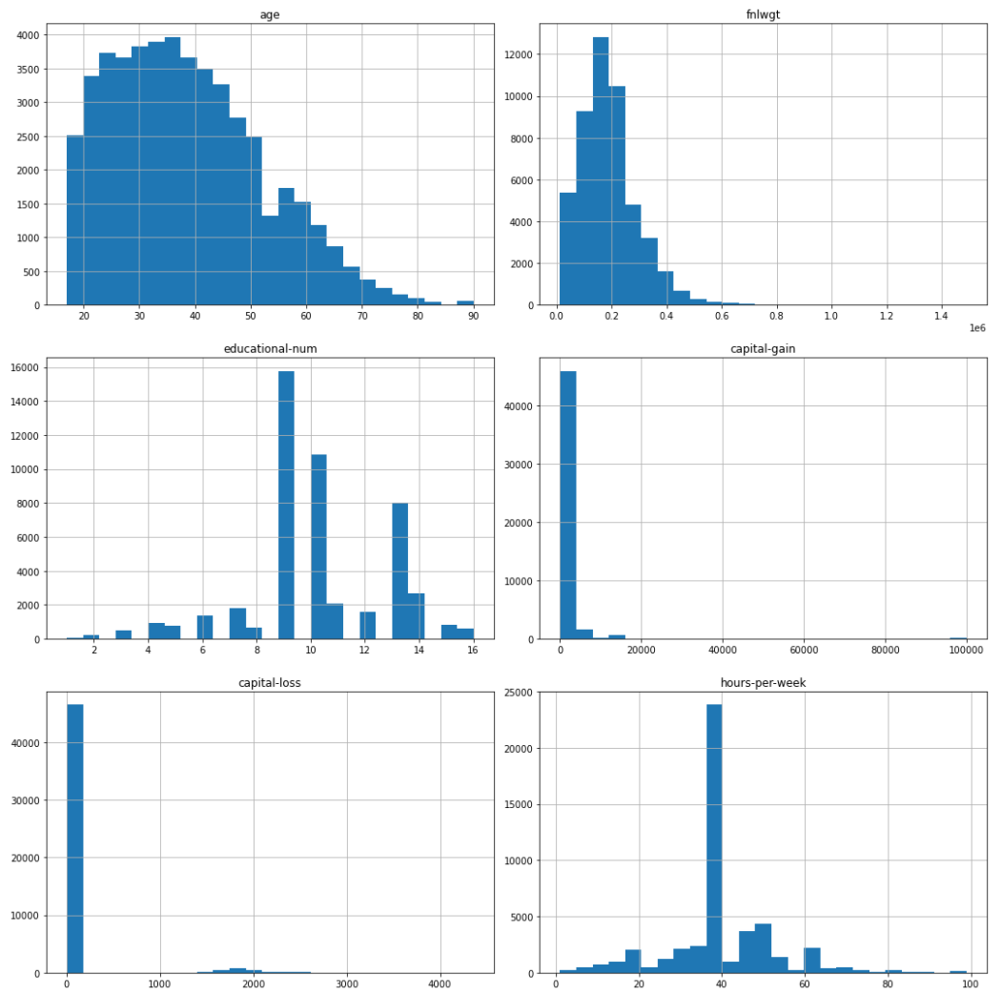
Distributions
"age" attribute is not symmetric.
Minimum and Maximum age of the people is 17 and 90 respectively.
In this data the hours per week attribute varies within the range of 1 to 99.
Most people work 30-40 hours per week, they are roughly 27,000 people.
There are also few people who works 80-100 hours per week and some less than 20 which is unusual.
75 percentage of the people spend 45 or less working hours per week.
Notes:
Description of select distributions
Age
"age" attribute is not symmetric.
Minimum and Maximum age of the people is 17 and 90 respectively.
Hours per week
In this data the hours per week atrribute varies within the range of 1 to 99.
Most people work 30-40 hours per week, they are roughly 27,000 people.
There are also few people who works 80-100 hours per week and some less than 20 which is unusual.
75 percentage of the people spend 45 or less working hours per week.

Slide 5
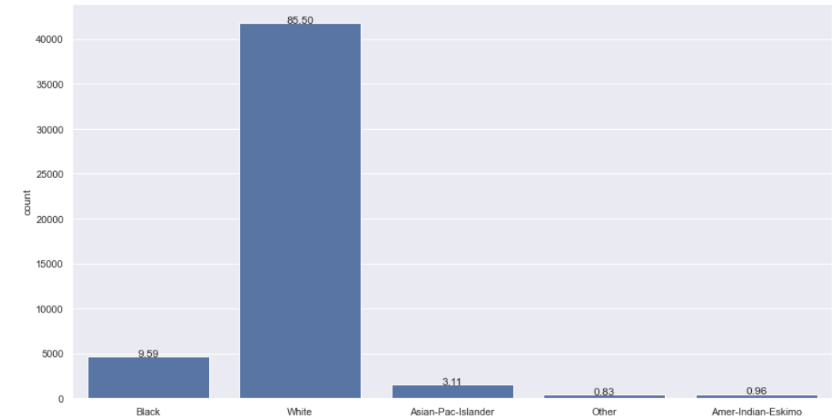
Race
There are 5 unique categories in the race attribute.
Most of them are "white" which is roughly 85.50%.
This dataset is totally bias toward the "white" race.
Second major race in the dataset is the "black" with just 9.59%.
Notes:
* There are 5 unique categories in the race attribute.
* Most of them are "white" which is roughly 85.50%.
* This dataset is totally bias toward the "white" race.
* Second major race in the dataset is the "black" with just 9.59%.

Slide 6
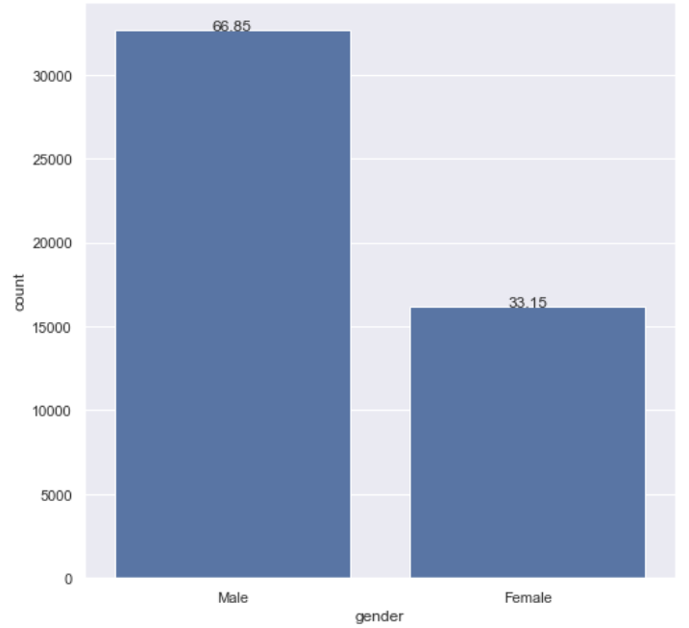
Gender
Gender
For "female" earning more than 50k is rare with only 3.62% of all observations.
But for male, 20.31% of all people earn more than 50k.

Slide 7
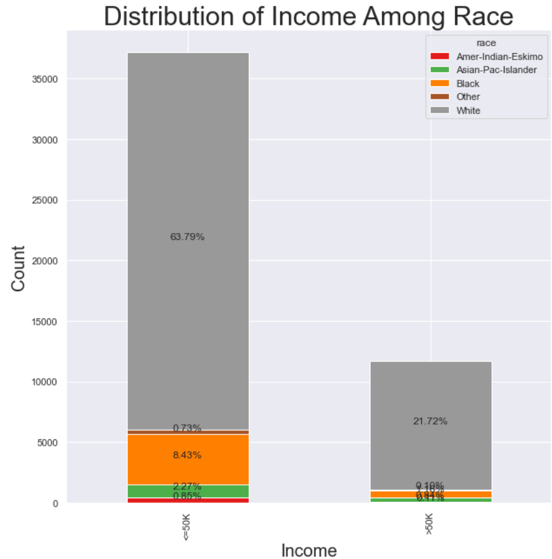

Slide 8
Does race have a significant affect on income?
H0(Null Hypothesis) : There is no relationship between race and income.
H1(Alternate Hypothesis) : There is a relationship between race and income.
The chi-square statistical test is used to determine whether there’s a significant difference between an expected distribution and an actual distribution.
After performing the chi squared test our p value is close to zero.
We can conclude that is there is a dependency of "race" attribute on the variable "income".

Slide 9
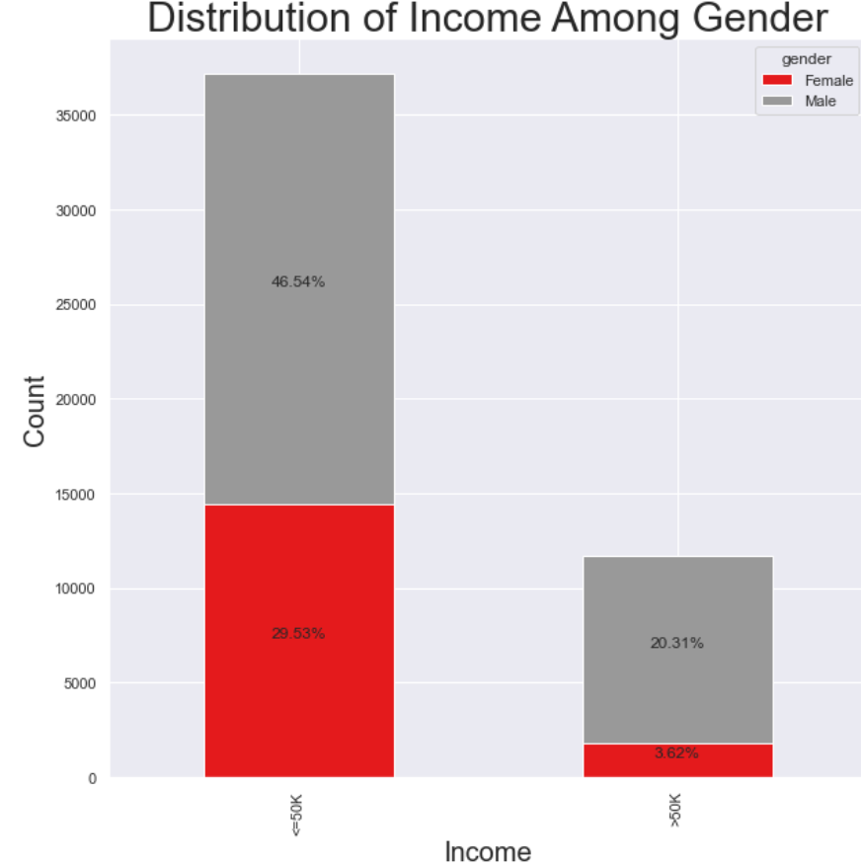

Slide 10
Does gender have a significant effect on income?
H0(Null Hypothesis) : There is no relationship between gender and income.
H1(Alternate Hypothesis) : There is a relationship between gender and income.
Again, the p-value is close to zero.
We can conclude that there is a dependency of "gender" attribute on the target variable "income".

Slide 11
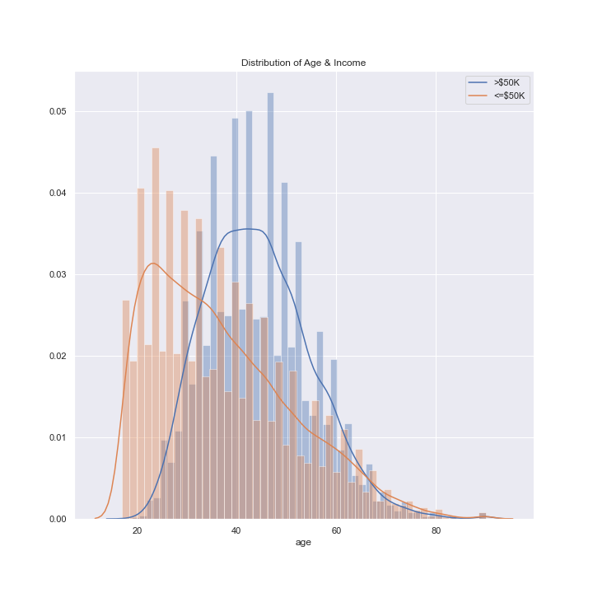
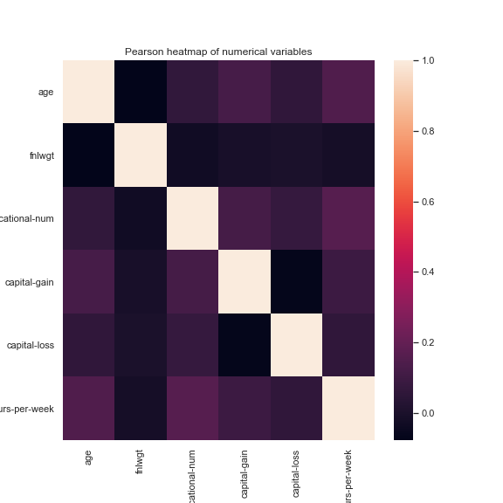
Other Considerations
We can see, in general, the older you are the more money you make. Older people have had more time to accumulate wealth.
There is no strong correlation among the numeric attributes.

Slide 12
Conclusions
Going back to our example, statistically, are the odds stacked against a black woman?
Since both gender & race have a significant effect on income, we can conclude it is more likely a black woman makes less than 50k a year than, say, a white male.
With this information in mind, it's important to investigate the reasoning behind this discrepancy in order to ensure, regardless of demographics, everyone has a fair chance to succeed.

